Slide 1
Evaluating the Performance of GPU Classification Based on Graphics Memory Type
A Comparative Study of Three Algorithms
10 February 2023 | Lemgo

Slide 2
Overview
Introduction
Motivation
State of the Art
Solutions
Experiments and Results
Summary and Outlook

Slide 3
Overview
Introduction
Motivation
State of the Art
Solutions
Experiments and Results
Summary and Outlook

Slide 4
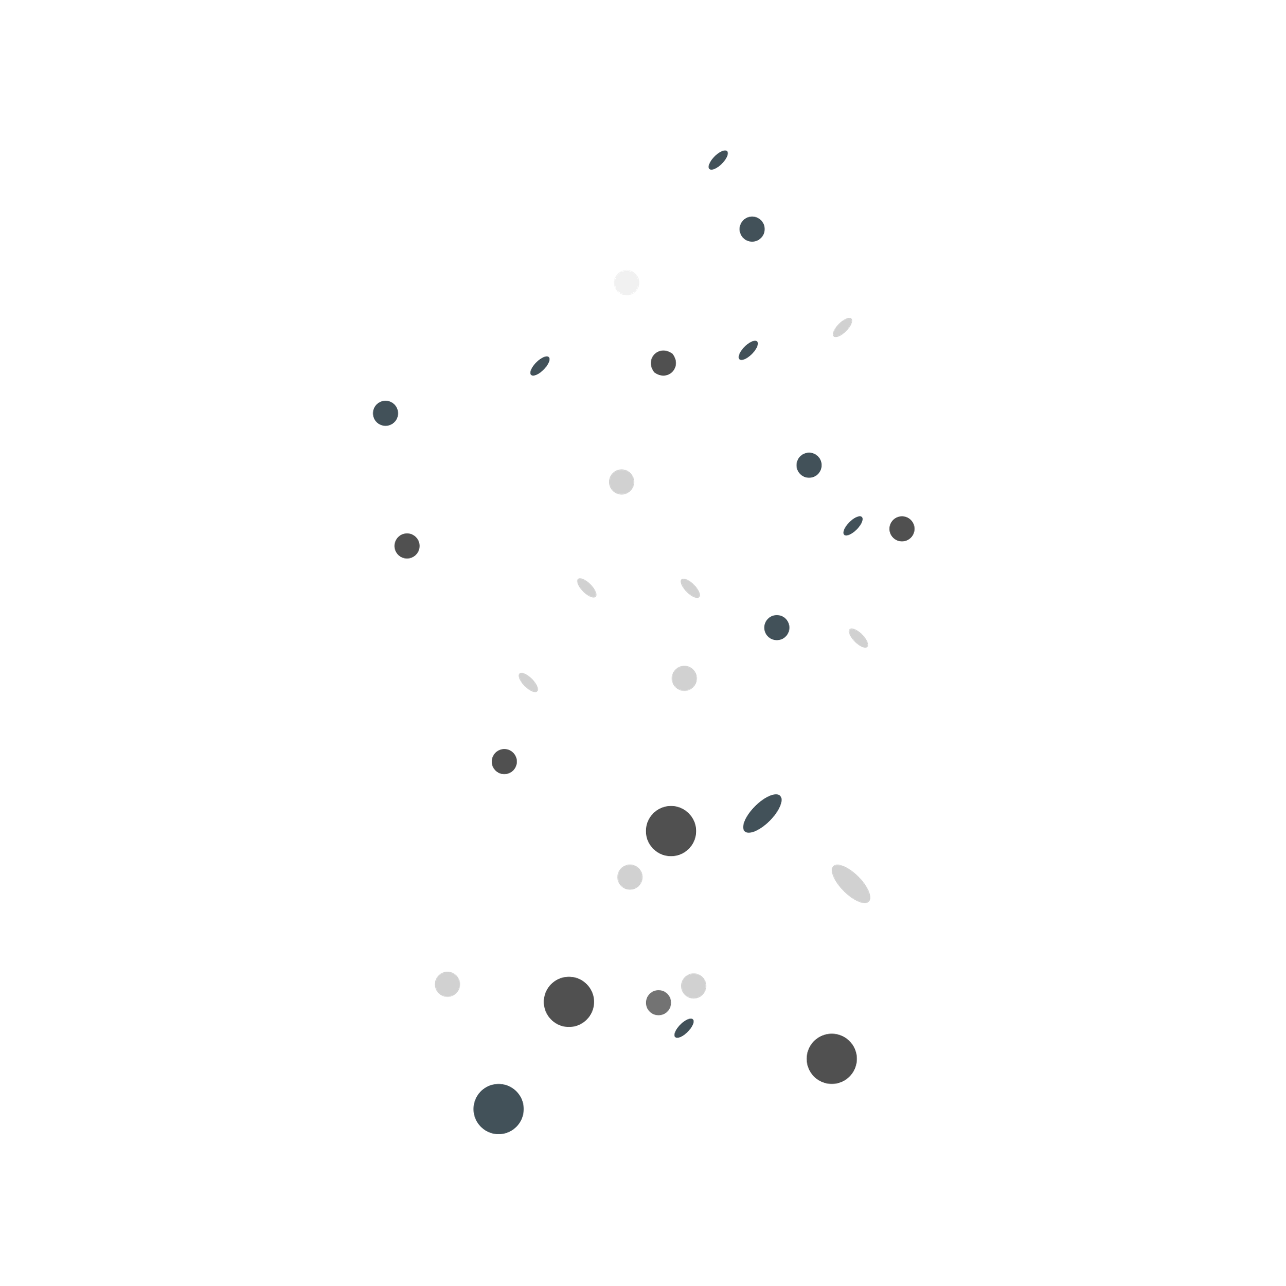
Introduction
GPU Classification
Machine learning
Three algorithms
DTC
RFC
SVM

Slide 5
Overview
Introduction
Motivation
State of the Art
Solutions
Experiments and Results
Summary and Outlook

Slide 6

Motivation
Personal Experience – Product recommendations
Ever demanding technology world
Increasing number of products being launched
Difficult to keep track
Processing a large amount of data

Slide 7

Why ML?
Availability of multiple solutions
Readily available libraries
Easy to understand language (Python)
Expertise in data mining

Slide 8
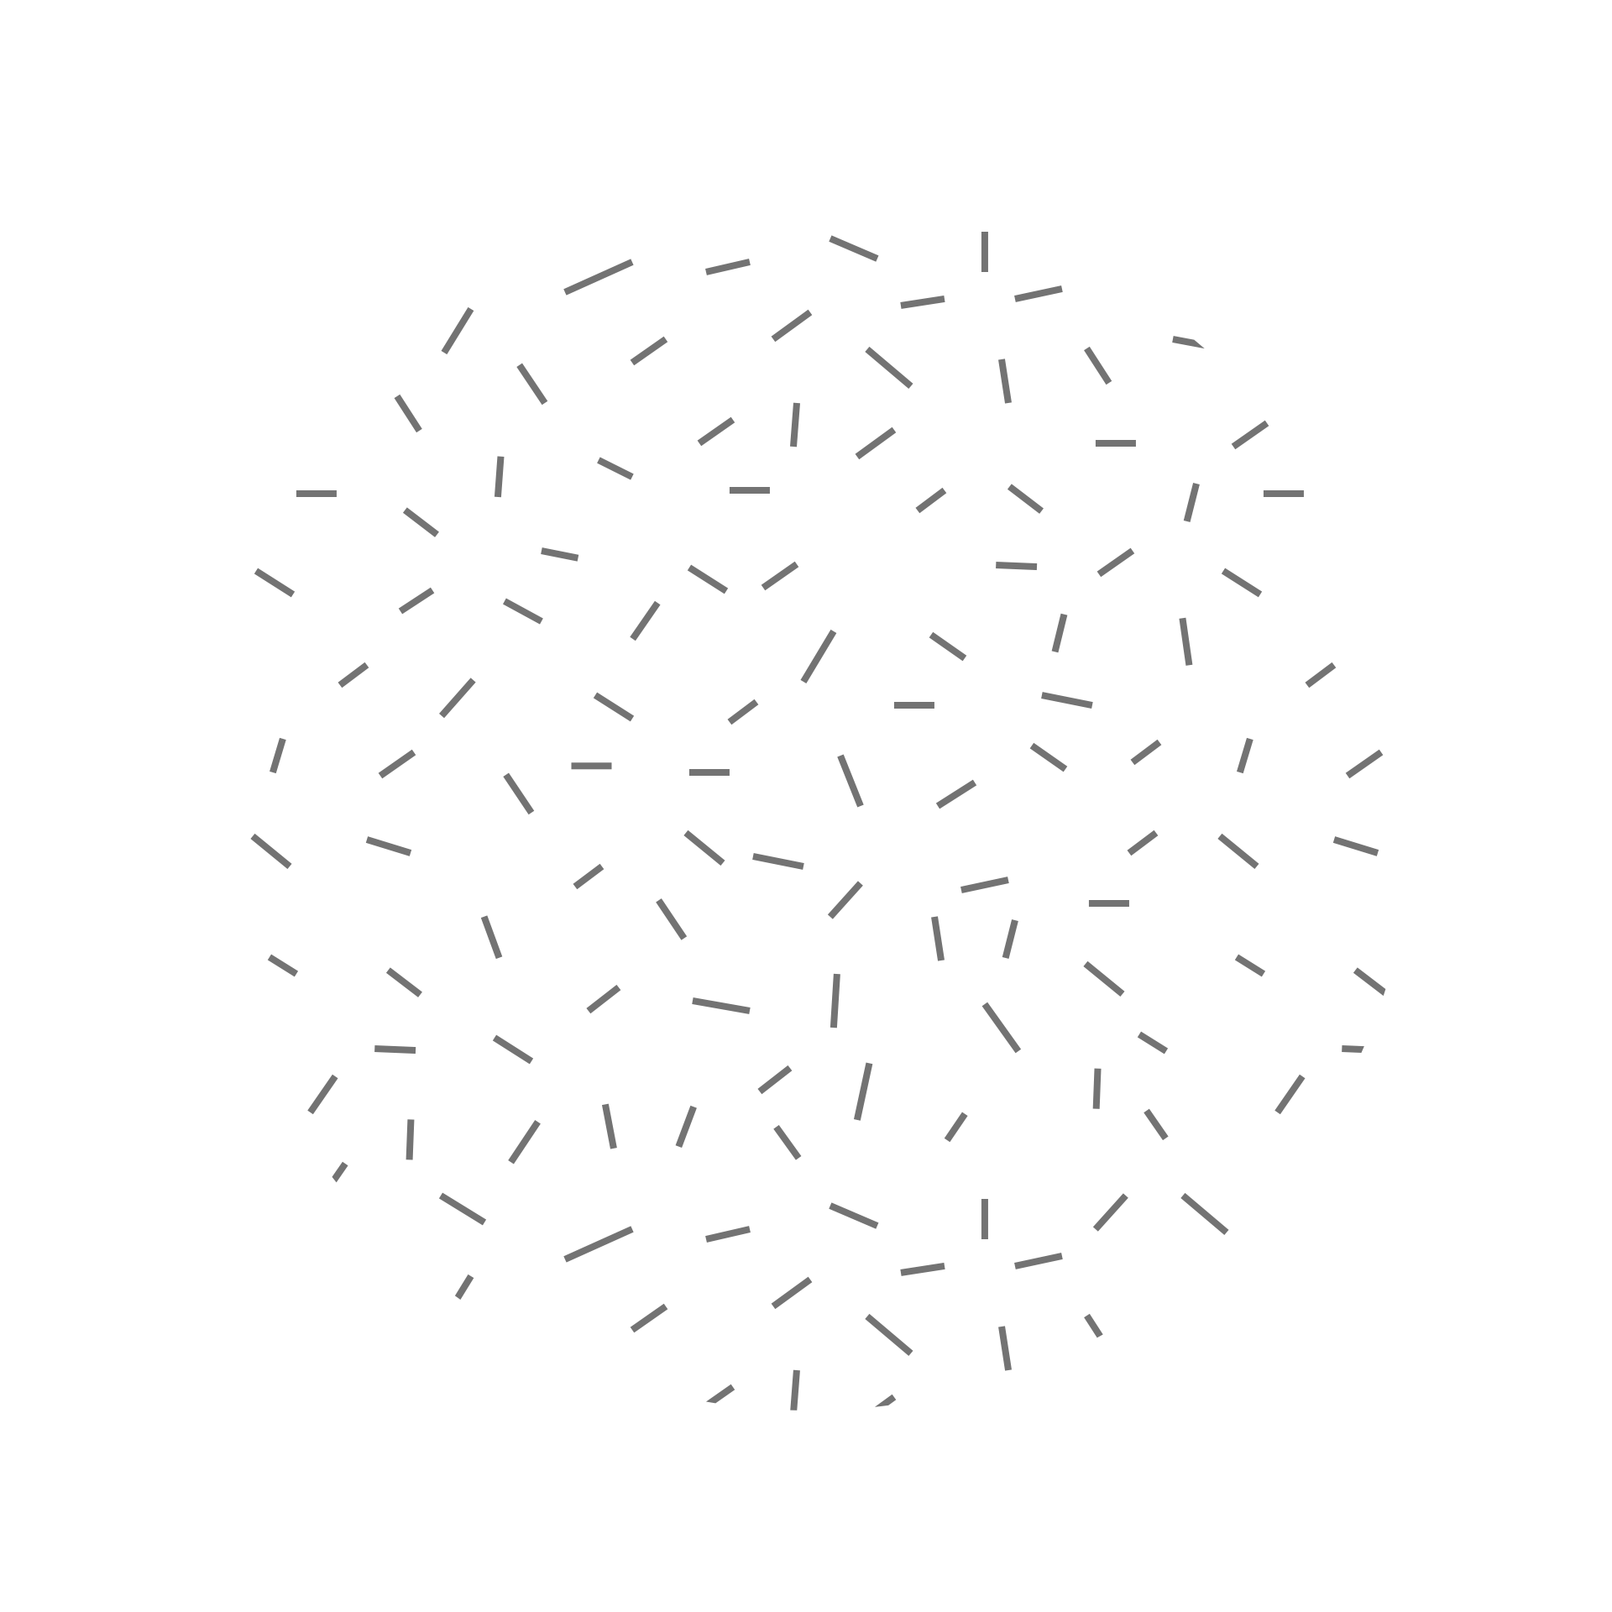
Focus of the study
Supervised learning
Classification
Multi-label Classification

Slide 9
Overview
Introduction
Motivation
State of the Art
Solutions
Experiments and Results
Summary and Outlook

Slide 10

Multi-class classification
Predict one of the multiple possible classes
More than 2 classes
Ex: Plant species
One-vs-all
One-vs-one (softmax)
Notes:
Multi-class classification is a type of supervised machine learning problem where the goal is to predict one of multiple possible classes for a given input sample.
Unlike binary classification, where the number of classes is 2, multi-class classification deals with more than 2 classes.
Examples of multi-class classification include image classification (e.g., identifying the species of a plant from an image), speech recognition (e.g., recognizing spoken words), and sentiment analysis (e.g., classifying text as positive, negative, or neutral).
Multi-class classification algorithms can be divided into two categories: one-vs-all (also known as one-vs-rest) and softmax (also known as multinomial logistic regression).
The one-vs-all approach trains a separate binary classifier for each class, where the class is treated as positive and all other classes are treated as negative. The class with the highest predicted probability is chosen as the final prediction.
The softmax approach trains a single classifier to predict a probability distribution over all classes, and the class with the highest predicted probability is chosen as the final prediction.
Common evaluation metrics for multi-class classification include accuracy, precision, recall, F1-score, and confusion matrix.

Slide 11

Classifiers
Decision tree classifier
Random forest classifier
Support vector machine

Slide 12
Overview
Introduction
Motivation
State of the Art
Solutions
Experiments and Results
Summary and Outlook

Slide 13

Decision Tree Classifier
The node - Test condition on feature
The branches - represent the outcomes of the test condition
The leaves - prediction of the target variable
Can handle both numerical and categorical data
Overfitting - especially when the tree is deep
Notes:
A Decision Tree is a tree-based model used for both regression and classification tasks. The tree is made up of internal nodes, branches, and leaves. The following are key points about decision trees:
Each internal node represents a test condition on a feature.
The branches from the node represent the outcomes of the test condition.
The leaves of the tree represent the prediction of the target variable.
The decision tree is constructed by recursively splitting the data based on the feature that gives the highest information gain (or reduction in entropy) until the tree reaches a stopping criterion, such as a minimum number of samples per leaf or a maximum depth of the tree.
The prediction for a new sample is made by traversing the tree from the root to a leaf based on the outcomes of the test conditions at each internal node.
Decision trees are easy to understand and interpret, and they can handle both numerical and categorical data.
They can easily capture complex non-linear relationships between features and the target variable.
However, decision trees are prone to overfitting, especially when the tree is deep, which can lead to poor generalization performance on unseen data.
To overcome overfitting, several techniques such as pruning, bagging, and random forests can be used.

Slide 14

Random Forest Classifier
Type of ensemble learning method for classification (and regression) problems
Consists of many decision trees
Each tree is trained on a randomly selected subset of the data, and a random subset of features
Each tree casting a unit vote for the most popular class at an input
Can handle missing values, outliers, and irrelevant features and is generally less prone to overfitting
Notes:
Random Forest is a type of ensemble learning method for classification (and regression) problems
It consists of many decision trees (hence "forest")
Each tree is trained on a randomly selected subset of the data, and a random subset of features to consider at each split
During prediction, the class (or value) of an instance is determined by aggregating the predictions of all the trees (usually through a majority vote for classification, or average for regression)
Random Forest can handle missing values, outliers, and irrelevant features and is generally less prone to overfitting than a single decision tree.
The model is easy to train, and the predictions are fast, making it a popular choice for many real-world applications.
Hyperparameters of the Random Forest model include the number of trees in the forest and the number of features to consider when splitting a node.

Slide 15
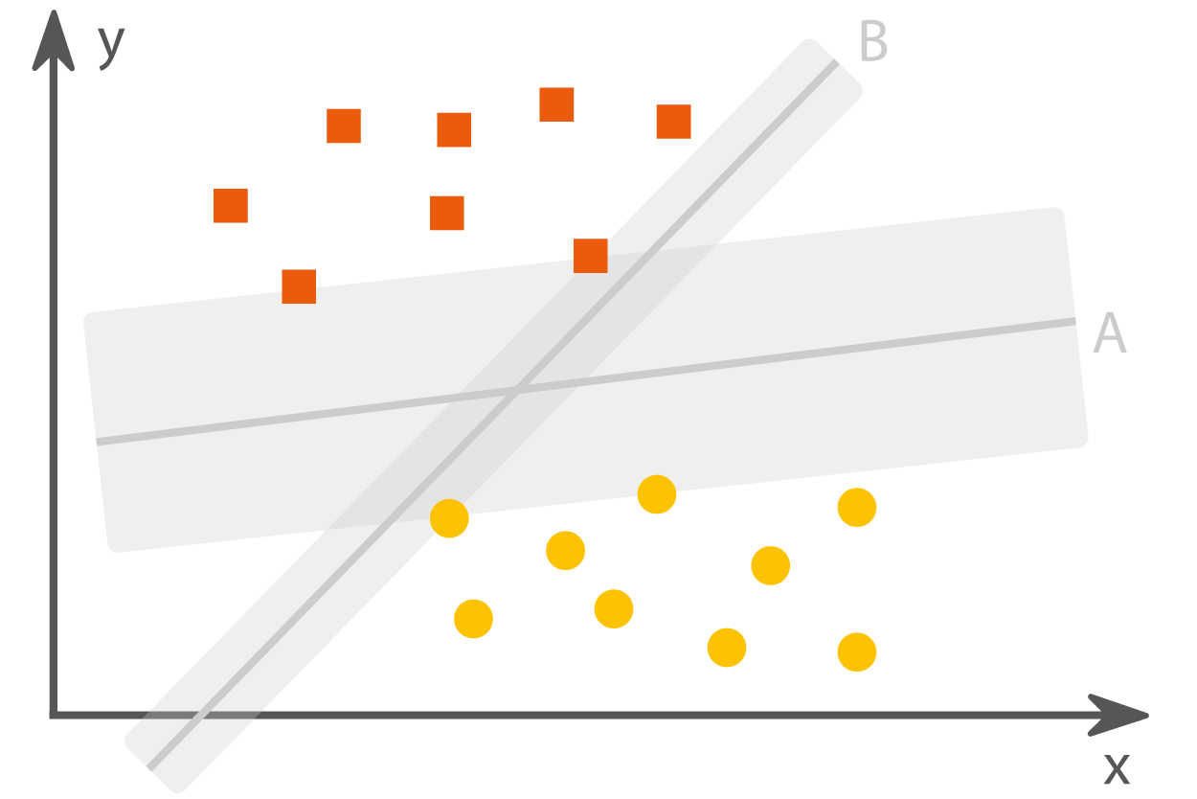
Support Vector Machine
Handle non-linearly separable data – Kernel function
Effective in high dimensional spaces and cases where the number of features is greater than the number of samples
Predictions based on distances of new data points to the hyperplane in the feature space
Low training error and high testing error, suitable for real world application
Notes:
Support Vector Machine (SVM) is a supervised learning algorithm used for classification and regression tasks. Here are the key points about SVM:
It is used to find the hyperplane that best separates the data into different classes.
The hyperplane is selected such that it has the maximum margin, i.e., the maximum distance between the hyperplane and the closest data points of each class.
These closest data points are called support vectors, and they have a crucial role in determining the hyperplane.
SVM can handle non-linearly separable data by using a kernel function to transform the data into a higher dimensional space where a linear separation is possible.
SVM is a robust and effective algorithm, especially in high dimensional spaces and cases where the number of features is greater than the number of samples.
The prediction is made based on the distances of new data points to the hyperplane in the feature space.
SVM can be used for both classification and regression problems by appropriate choice of the loss function.
SVM has a good generalization ability, i.e., it has low training error and high testing error, making it suitable for real-world applications.

Slide 16
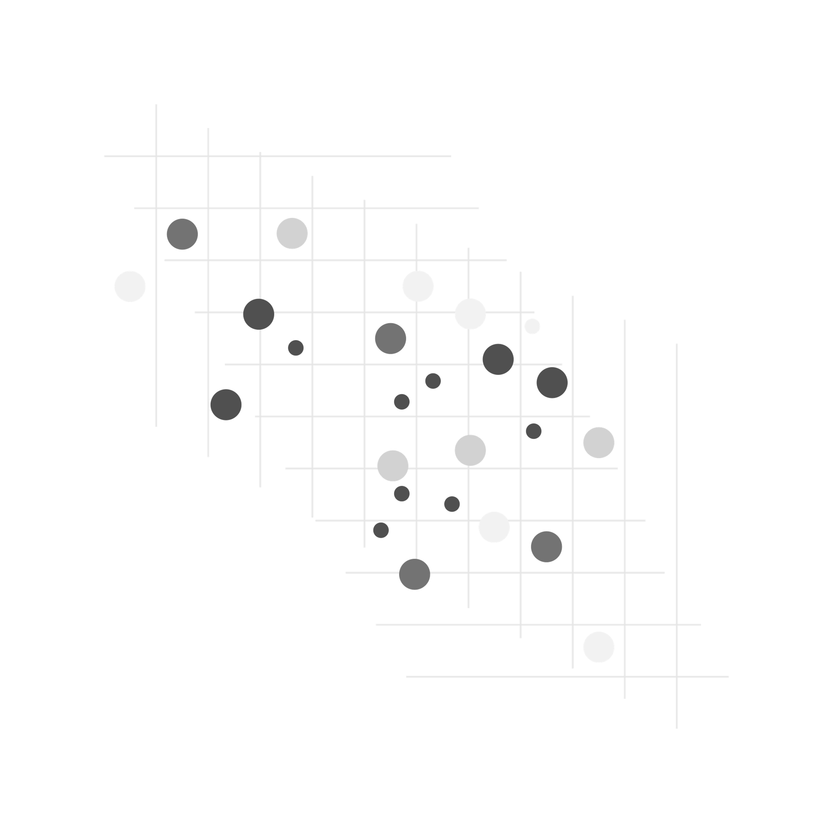
Performance Metrics
Confusion Matrix
Accuracy
Precision
Recall
F1
Execution Time
racy
Cross-validation – StratifiedKfold
Accuracy
Execution Time

Slide 17

Why StratifiedKfold?
Class imbalance
Model evaluation
Better performance
Notes:
StratifiedKFold is often preferred over KFold for several reasons:
Class imbalance: If the target variable is imbalanced, meaning some classes have a significantly higher number of samples compared to others, using KFold could result in folds that do not represent the class distribution. This could lead to poor performance and over- or under-estimation of the model's ability to generalize to new data. StratifiedKFold, on the other hand, ensures that each fold has a representative mix of all classes.
Model evaluation: In some cases, the performance of a model depends on the distribution of the target variable. StratifiedKFold helps ensure that the performance of a model is evaluated on a representative sample of all classes.
Better performance: Since StratifiedKFold ensures that each fold has a representative mix of all classes, it can help in cases where the model's performance is sensitive to class distribution. This can lead to better performance compared to KFold.
Overall, StratifiedKFold is a better option when dealing with imbalanced datasets or models that are sensitive to the distribution of the target variable. However, in cases where the target variable is balanced and the model is not sensitive to class distribution, KFold can be used as well.

Slide 18
Overview
Introduction
Motivation
State of the Art
Solutions
Experiments and Results
Summary and Outlook

Slide 19
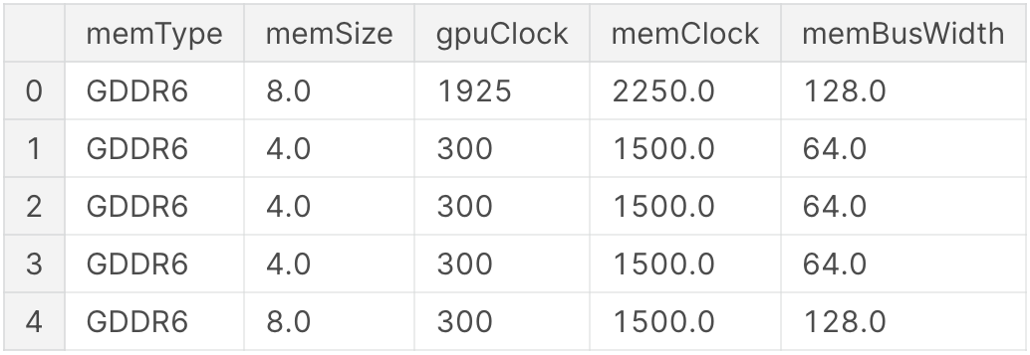
Data Preparation
Kaggle dataset – Data Mining UNDIP
2889 samples and 16 features
5 features considered
DV – Memory Type
Interpolation
Dataset split: 80% - Training, 20% - Test
Pearson’s correlation test
Dataset snapshot

Slide 20
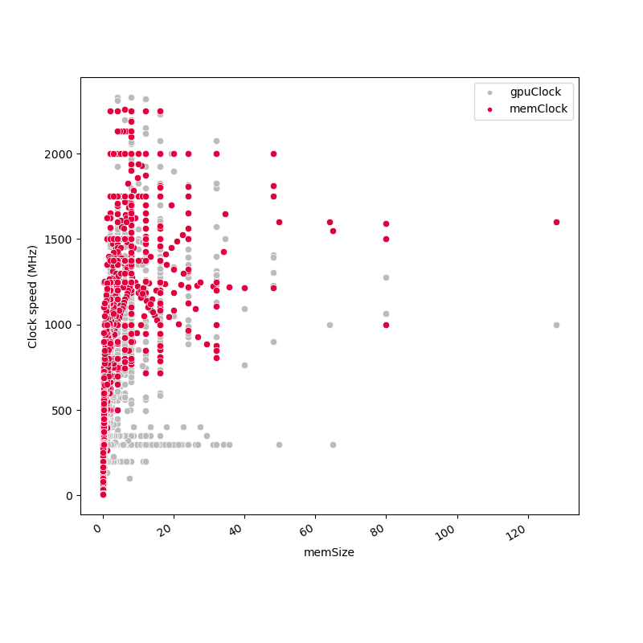
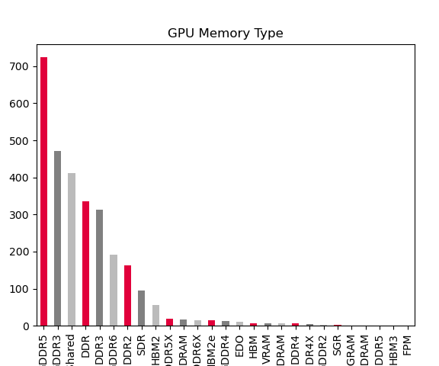
Dataset visualisation

Slide 21

Algorithm Training
Models were trained using selected features:
Memory Size
GPU Clock
Memory Clock
Memory Bus Width

Slide 22

Evaluation
Confusion matrix
Accuracy
Precision
Recall
F1
Cross-validation
Over 1200 tests – to avoid OS scheduling effect
Accuracy
Execution Time (Train and Predict)

Slide 23
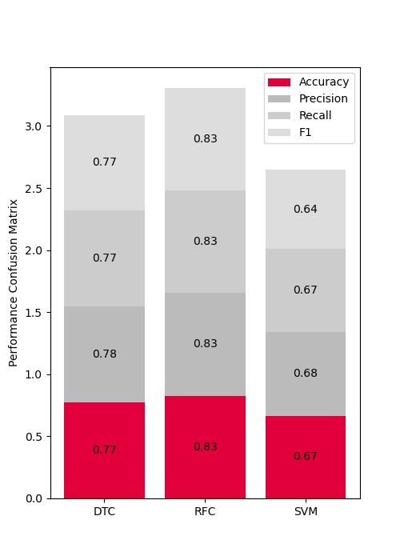
Confusion matrix results
Overall, RFC performed best
DTC performed well
SVM performed poorly

Slide 24
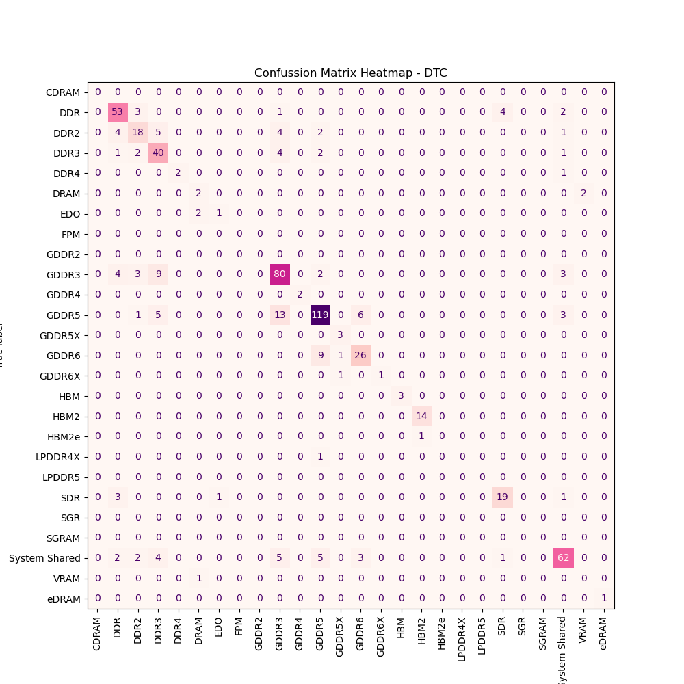

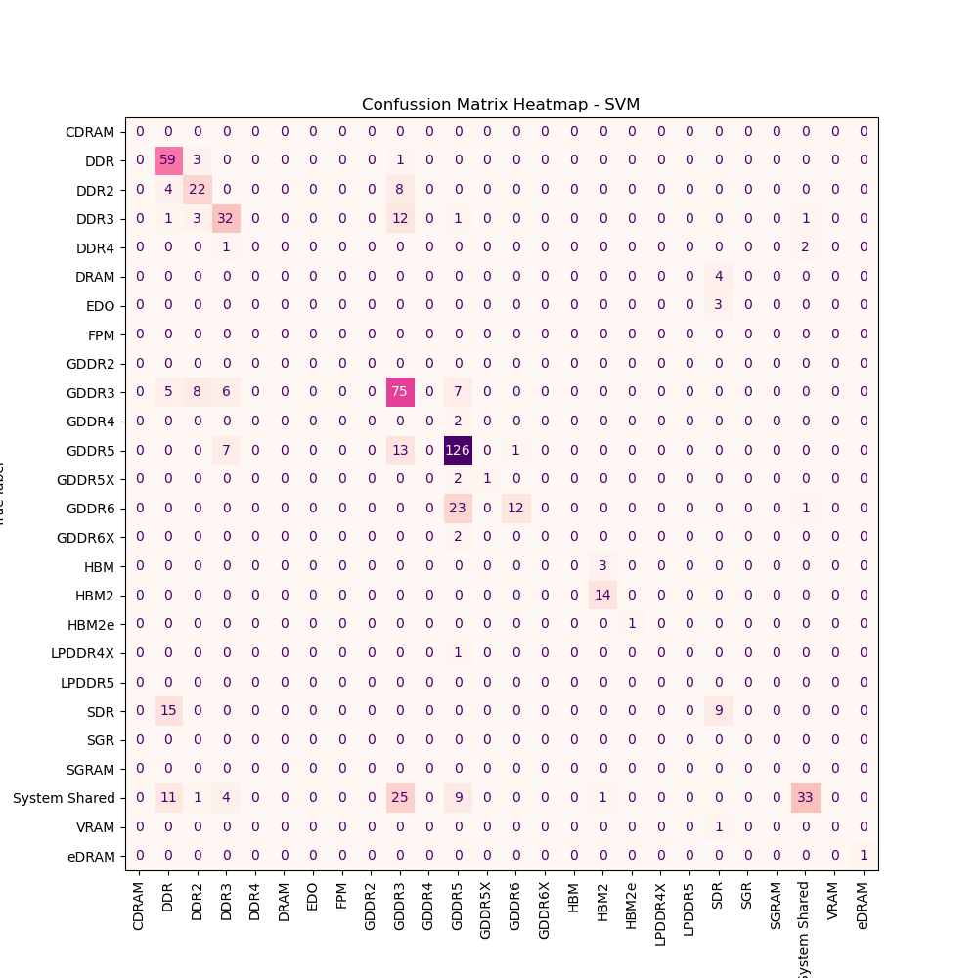
Confusion Matrix Heatmap
DTC
RFC
SVM

Slide 25
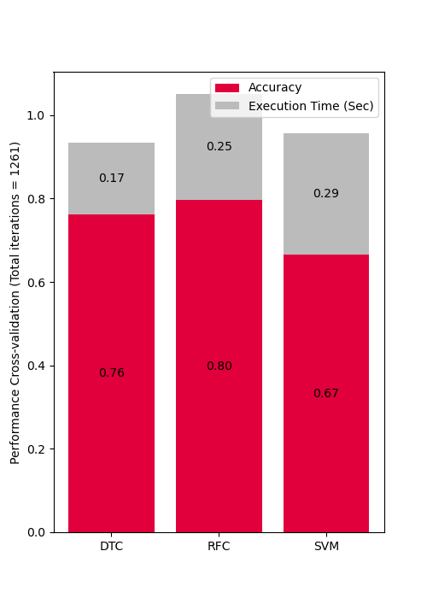
Cross-validation results
Results are average of over 1200 tests
In execution time, DTC performed the best
RFC performed well
SVM took the highest time

Slide 26
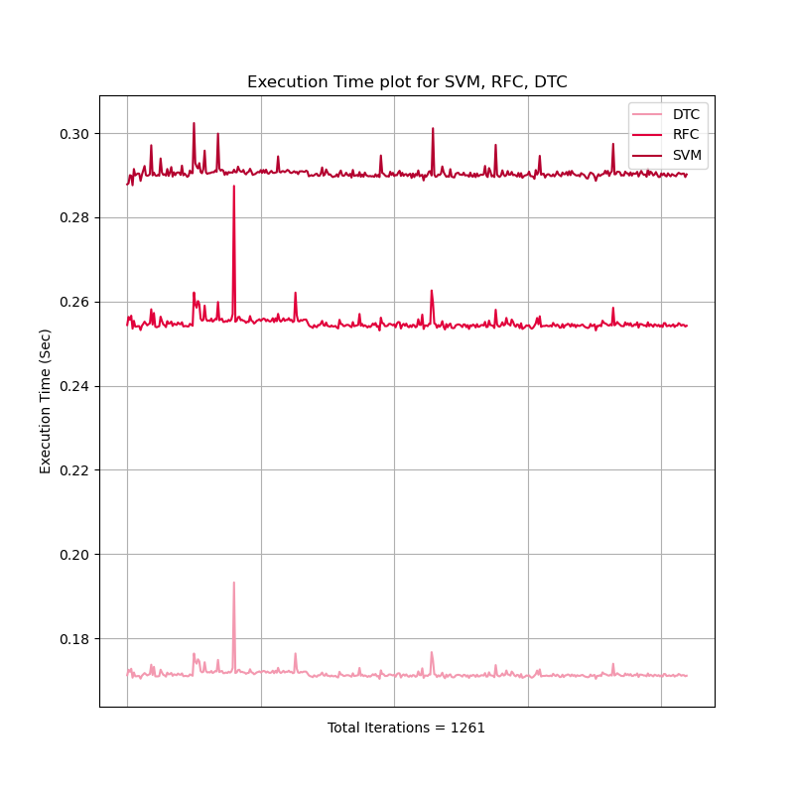
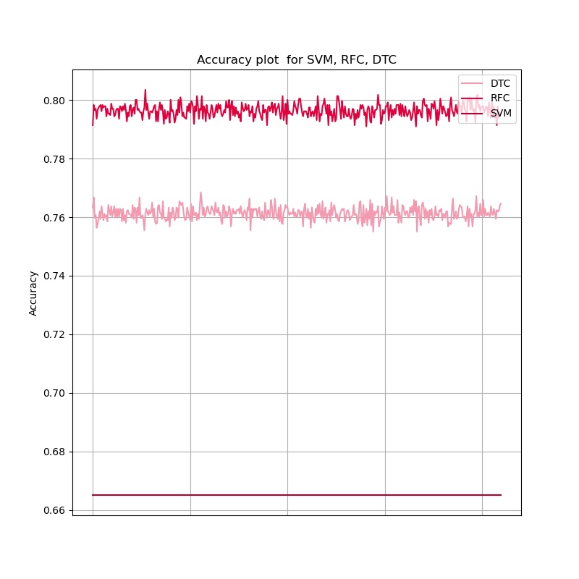
Performance consistency

Slide 27
Combined results
RFC
Accurate
Fast
Precise
DTC
Less accurate
Fastest
Less precise
SVM
Least accurate
Slowest
Least precise
Classifier | Accuracy (CV) | Accuracy (CM) | Precision | Recall | F1 | Execution Time
DTC | 0.77 | 0.76 | 0.78 | 0.77 | 0.77 | 0.17
RFC | 0.83 | 0.80 | 0.83 | 0.83 | 0.83 | 0.25
SVM | 0.67 | 0.67 | 0.68 | 0.67 | 0.64 | 0.29

Slide 28
Overview
Introduction
Motivation
State of the Art
Solutions
Experiments and Results
Summary and Outlook

Slide 29

Summary and Outlook
RFC has the highest accuracy, followed by DTC and SVM
Evaluation based on Accuracy, Precision, Recall, F1 score and Execution time.
No parameter optimization
Utilizes ML to effectively classify GPU based on memory type
Solution can be extended to other technology products
GIT Codespace Repository Link

Slide 30
Summary
Introduction
Motivation
State of the Art
Solutions
Experiments and Results
Summary and Outlook

Slide 31

Questions
Questions

Slide 32
Thank you!

